Slide 1


FYP-I
FastGrid
Project Supervisor
Miss Soofia
Bilal Ahmed Siddiqui
Muhammad Taha Khan
Muhammad Usman Afzal
Department of Information Technology, FEST
Hamdard University

Slide 2
FastGrid — Project Summary
A high-performance, reusable grid library for WPF applications.
Uses SkiaSharp immediate-mode rendering instead of creating a UI element for every cell.
Target: smooth interaction with large datasets, including 100,000 rows.
FYP-I status: MORE than the 30% milestone is complete - a working, packaged library (SkiaSharpControlV2 v1.0.2) with 552 passing unit tests and a GitHub Actions CI/CD pipeline.

Slide 3
Problem Statement
WPF DataGrid can degrade when datasets become large or update frequently.
Traditional element-per-cell rendering creates substantial layout, measure, and visual-tree overhead.
The result can be high frame times, scrolling lag, and poor responsiveness.
FastGrid addresses the rendering bottleneck through immediate-mode drawing.

Slide 4
Objectives
Performance: achieve sub-5 ms baseline frame time for the target workload.
Scalability: support interactive navigation of datasets up to 100,000 rows.
Features: provide essential grid interactions such as scrolling, selection, and column/row presentation.
Reusability: package the solution as a reusable NuGet library.
Quality & Cloud Ops: automate build/test/package workflows and collect performance telemetry.

Slide 5
FYP Scope
In scope: WPF grid control, SkiaSharp renderer, data/view abstraction, grid managers, metrics, tests, packaging.
In scope: GitHub Actions CI/CD pipeline and NuGet package distribution - both now in use.
FYP-I milestone target was a 30% proof-of-concept; the delivered scope is well beyond that (see Change of Scope).
Proof-of-concept target met and exceeded: live scrolling and measured frame time at 100,000 and 1,000,000 rows.
Deferred to FYP-II: the cloud telemetry dashboard and dirty-rectangle rendering.

Slide 6
Change of Scope
FYP-I milestone target: a proof-of-concept demonstrating roughly 30% of the work.
Actually delivered: MORE than 30% - a complete, versioned and packaged library, SkiaSharpControlV2 v1.0.2, with 552 passing unit tests.
Added beyond the original scope: grouping with six aggregations, conditional styling and triggers, in-cell buttons and commands, UI Automation, cross-application row drag-and-drop, TSV export, tooltips and density theming.
Brought forward: the GitHub Actions CI/CD pipeline and NuGet publishing are already in use, not just designed.
Deferred to FYP-II: the cloud telemetry dashboard, and dirty-rectangle rendering as the next performance step.
Notes:
Be direct: we over-delivered on the library and the pipeline, and deliberately deferred the cloud dashboard. The reason the feature set grew is that you cannot benchmark a renderer honestly without triggers, grouping and live updates inside the workload.

Slide 7
Our Methodology
1. Analyze WPF DataGrid rendering and identify performance bottlenecks.
2. Design a layered architecture separating control, data, managers, rendering, and automation.
3. Implement a SkiaSharp immediate-mode rendering prototype.
4. Benchmark frame time and validate behavior using large datasets.
5. Integrate CI/CD, package distribution, and telemetry for operational readiness.

Slide 8
Tools & Technologies
Language & Runtime - C# on .NET 8 (net8.0-windows); WPF with XAML and the MVVM pattern.
Rendering - SkiaSharp.Views.WPF 3.116.1 (SKElement) over the native Skia 2D graphics engine.
Testing - xUnit 2.5.3, NSubstitute 5.1.0, Coverlet, Microsoft.NET.Test.Sdk 17.8.0 (552 tests).
Accessibility - .NET UI Automation (AutomationPeer framework).
CI/CD - GitHub Actions: build, test, pack and publish, gated on a green test run.
Source control & Packaging - Git / GitHub (Bilalahmedsd/SkiaGrid); NuGet package SkiaSharpControlV2 v1.0.2, MIT licence.
Design & Documentation - draw.io (diagrams.net) for architecture, DFD, Gantt and deployment charts.
Profiling - built-in GridMetrics instrumentation (Stopwatch scopes, counters, p50/p95/p99) with a live Performance Dashboard.
Notes:
Everything here is free or student-licensed, which is what the Budget slide claims. SkiaSharp is the only substantive third-party runtime dependency.

Slide 9
Project Plan - 4 Phases, 8 Meetings
Phase 1 - Problem Definition & Literature Review (M1 16 May, M2 23 May): present the problem, position FastGrid, agree scope; compare native DataGrid against DevExpress / Syncfusion / Telerik and immediate-mode drawing; confirm the stack.
Phase 2 - Requirements & SRS (M3 30 May, M4 15 Jun): functional requirements (render, sort, filter, group, select, style, buttons, tree, export, automation) and non-functional (sub-5 ms, 100k+ rows, usability, reliability, accessibility); use-case diagram, traceability, acceptance criteria; SRS signed off.
Phase 3 - Architecture, Design & DevOps (M5 27 Jun, M6 04 Jul): layered architecture, class diagram, paint-cycle sequence diagram, DFD levels 0-2; CI/CD pipeline architecture, deployment diagram, cloud registry and telemetry design.
Phase 4 - Implementation, Benchmark & Demo (M7 11 Jul, M8 18 Jul): SkiaSharp canvas rendering a large dataset with virtualization, baseline GridMetrics capture, 552 unit tests, NuGet release v2.18.0, consolidated presentation and PoC demo to the panel.
All 8 meetings held and signed off by the supervisor (FYP Fortnightly Sign-off Sheet, project code 89223).
Notes:
This plan is taken straight from the signed sign-off sheet, so every date and agenda item is verifiable - do not paraphrase it on the spot.
Phase gates: M2 stack confirmed, M4 SRS signed off, M6 architecture and CI/CD design signed off, M8 presentation and PoC demo to the panel.
The Gantt chart two slides later is the same plan drawn against those eight meetings.

Slide 10
RACI - Team Responsibility Matrix
Workstream | Bilal Ahmed Siddiqui | Muhammad Taha Khan | Muhammad Usman Afzal | Supervisor
Requirements & Literature Review | C | R | R | A
System Architecture & Design | R | C | C | A
SkiaSharp Rendering Engine | R | C | I | A
Data Layer (CollectionView, Filter/Sort/Group) | A | R | C | I
Input & Interaction (Mouse/Keyboard/Row Drag) | A | C | R | I
UI Automation & Accessibility | A | C | R | I
Performance Benchmarking & GridMetrics | R | A | C | C
Unit Testing & QA (552 tests) | C | R | A | C
CI/CD Pipeline & NuGet Release (v1.0.2) | R | C | A | I
Documentation, SRS & Defense Preparation | C | R | R | A
R = Responsible (does the work) A = Accountable (owns the outcome) C = Consulted I = Informed
Notes:
VERIFY THESE ASSIGNMENTS BEFORE THE DEFENSE - this is a draft derived from the code structure, not a record of who did what. Every row has exactly one A, which is the rule examiners check.

Slide 11
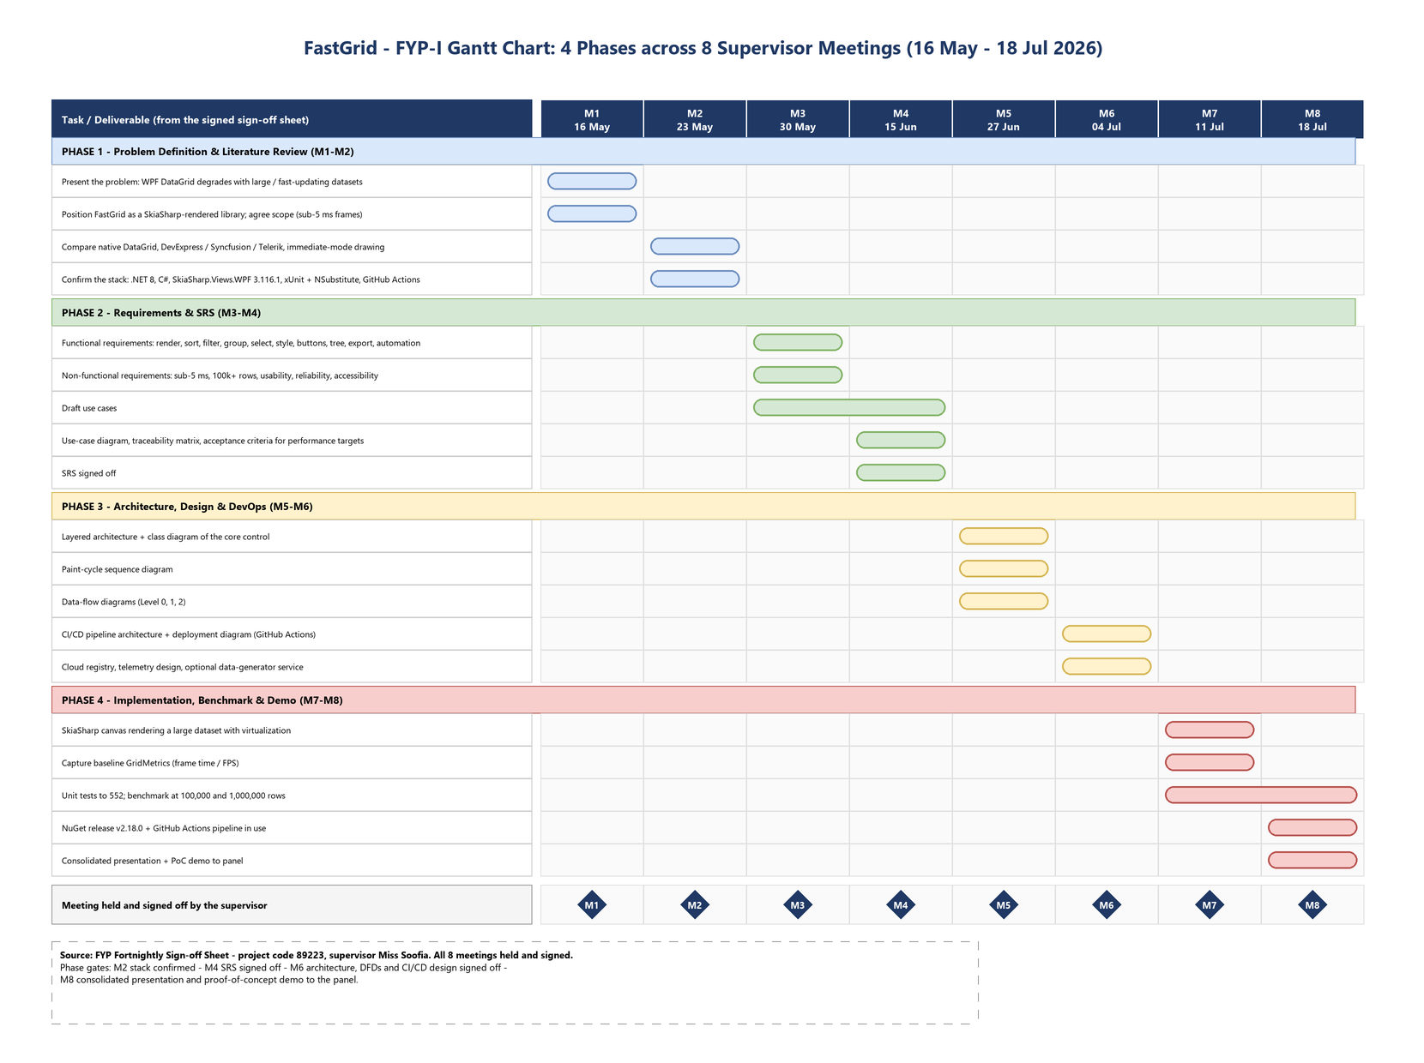
Gantt Chart - 4 Phases, 8 Meetings
Every row and date comes from the signed FYP Fortnightly Sign-off Sheet (project code 89223)
Notes:
The same plan drawn against the eight signed meetings, 16 May to 18 July 2026. Diamonds M1-M8 are the meetings, all held and signed. Point at the Phase 4 band: that is where the benchmark, the 552 tests and the NuGet release land.

Slide 12
Budget / Costing
Development tools: primarily open-source / student-available tooling.
SkiaSharp: open-source graphics library.
Cloud resources: use low-cost/free-tier resources where available for CI/CD, registry, and telemetry proof-of-concept.
Expected FYP-I cost: minimal; exact cloud cost depends on selected services and usage.

Slide 13
FYP Deliverables
FastGrid WPF library, packaged as NuGet SkiaSharpControlV2 v1.0.2 (MIT).
SkiaSharp-based immediate-mode grid renderer with 552 automated unit tests.
Data/view and grid-management components, plus UI Automation accessibility support.
Measured performance evidence: 2.59 ms at 100,000 rows and 2.75 ms at 1,000,000 rows.
GitHub Actions CI/CD workflow and NuGet distribution.
Documentation set: SRS, architecture diagram, DFD levels 0-2, deployment flow chart, Gantt chart, and a 306-member property/API reference.
Fast Grid Control
Managers
Renderer
Data / View
Automation
SK Canvas

Slide 14
Literature Review & Alternatives
Native WPF DataGrid: mature and integrated, but can incur visual-tree overhead at scale.
Commercial grids such as DevExpress, Component1, Avalonia, Telerik and Syncfusion: feature-rich but not providing accuracy.
Custom immediate-mode drawing: high control over rendering and performance, but requires more engineering.
FastGrid niche: a reusable WPF/NuGet component focused on lightweight, high-performance rendering plus cloud-native delivery.
Git Repo
CI/CD
NuGet Registry
Metrics / Logs
Telemetry

Slide 15
Demo of 30% Work - Proof of Concept
Status: MORE than 30% of the planned work is complete - what follows is the working product, not a mock-up.
100,000 rows generated and bound in 67 ms, then scrolled continuously: 2.59 ms average frame time, 4.00 ms at p95.
1,000,000 rows: 2.75 ms average frame time - the SAME cost, because only ~250 cells are ever drawn per frame.
All Features tab: every public property, method, event and command of the grid, driven live.
Four independently streaming trading desks side by side (Watchlist, Time & Sales, Trading Monitor, Options Chain).
552 automated unit tests running green in Visual Studio Test Explorer.
Notes:
Run SampleApplicationV2 - it opens on DemoWindow with seven tabs.
1) 100K Stress Test -> press 100,000, read the numbers, scroll, then press 1,000,000 and show the SAME frame time. That is the whole thesis in one click.
2) Tick 'Live ticks' - 2,000 rows change every 100 ms and it still holds.
3) All Features tab -> ApplyGroup, ExpandAllRows, GetAllPercentiles, header theming.
4) Multi-Window Test -> 'Tile 4 Windows'.
5) Row Drag -> open the drop-target window and drag rows out.
6) Test Explorer -> 552 green.
Say plainly that the rubric milestone was 30% and the delivered work exceeds it.

Slide 16
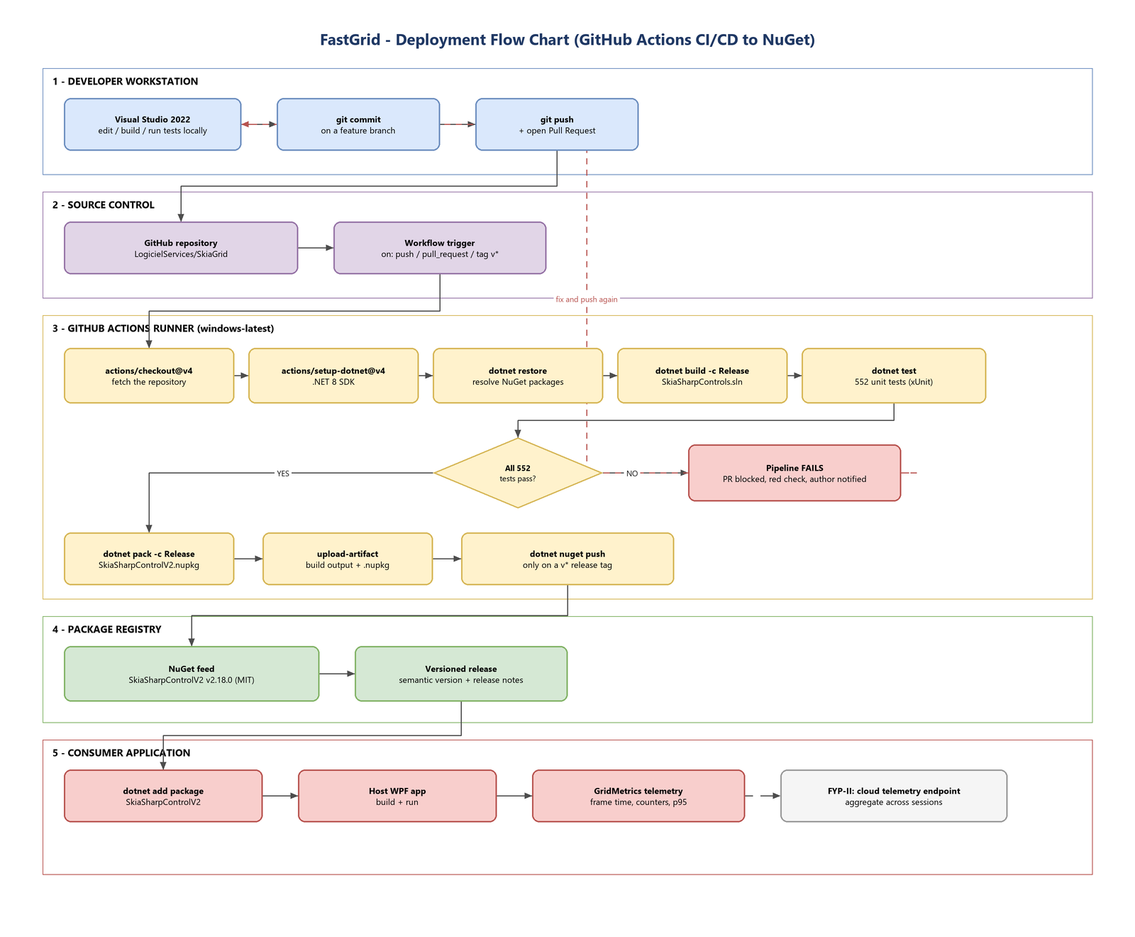
Deployment Flow Chart - CI/CD
Developer -> GitHub -> Actions runner (build, 552 tests, pack) -> NuGet -> consumer WPF app
Notes:
Five lanes: developer workstation, GitHub, the Actions runner, the NuGet registry, and the consumer application. The decision diamond is the gate that matters - a red test run blocks the PR, so nothing unpublished ever reaches the package feed.

Slide 17
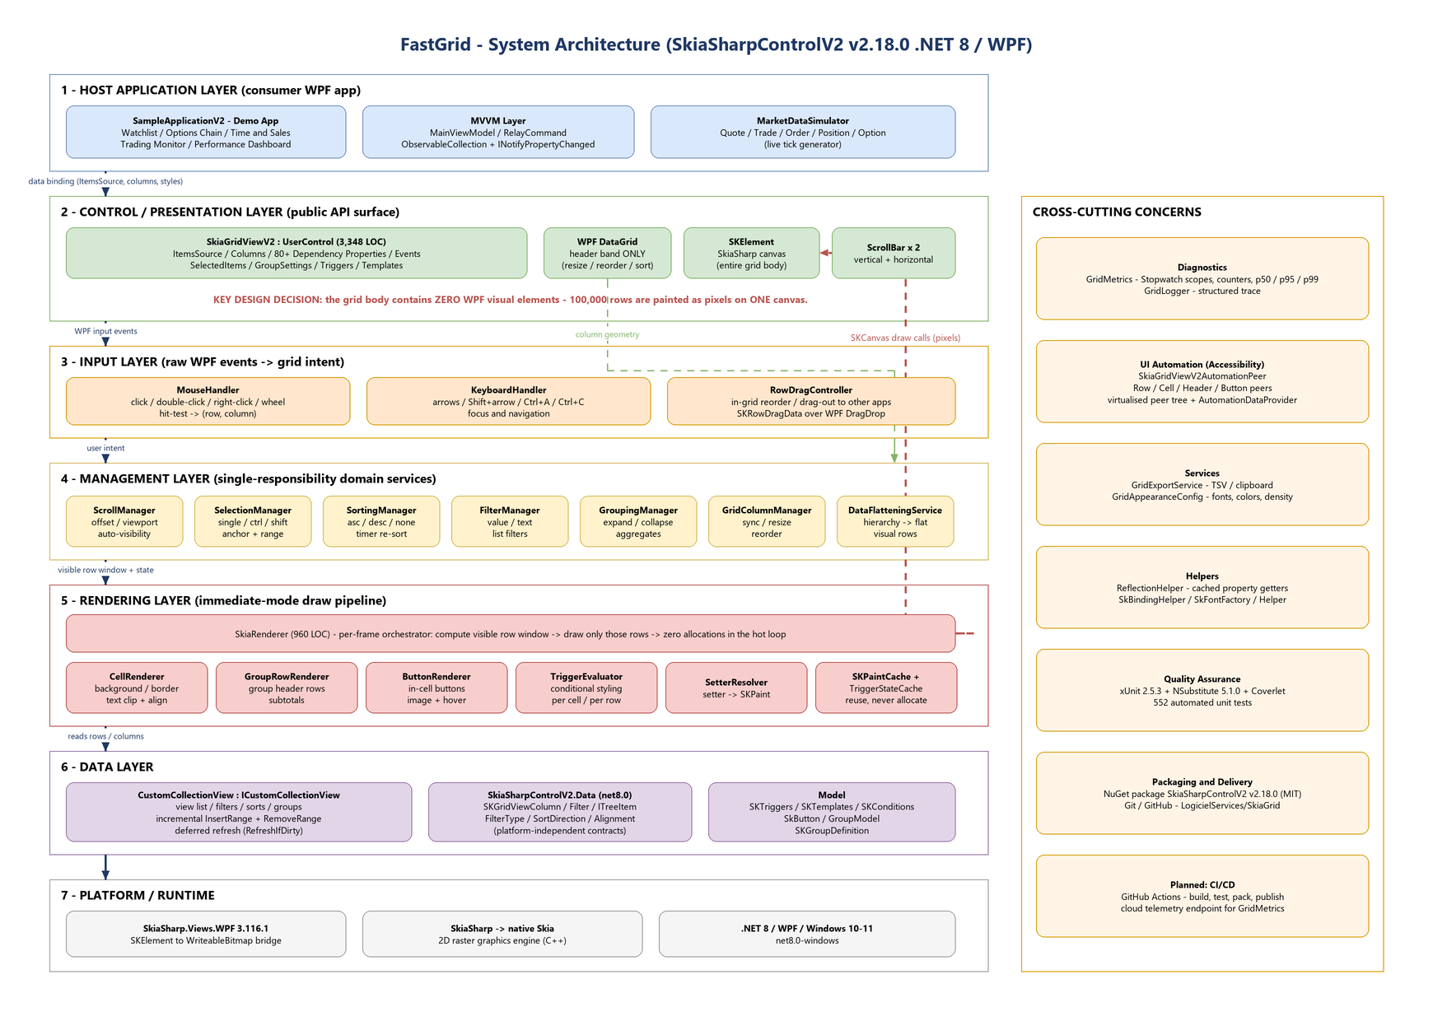
System Architecture
The grid body contains zero WPF visual elements - 100,000 rows are painted on one canvas
Notes:
Seven layers plus cross-cutting concerns. The one sentence that matters: the grid body contains ZERO WPF visual elements. The WPF DataGrid is kept ONLY for the column header band; everything below the header is pixels on a single SKElement canvas.

Slide 18
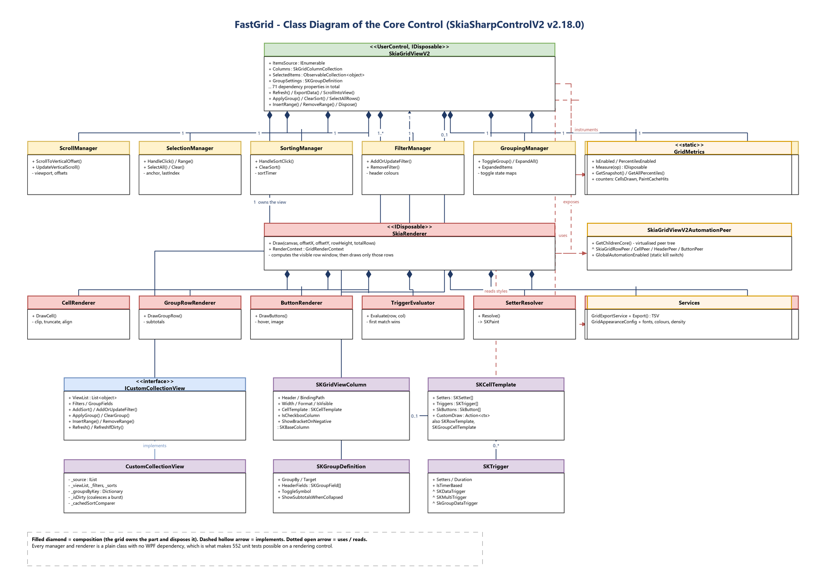
Class Diagram - Core Control
7 managers + 7 renderers + the data layer, all owned and disposed by SkiaGridViewV2
Notes:
Meeting-5 deliverable. Filled diamonds are composition - the grid owns each manager and renderer and disposes them. The point to make: every manager and renderer is a plain class with no WPF dependency, which is exactly what makes 552 unit tests possible on a rendering control.

Slide 19
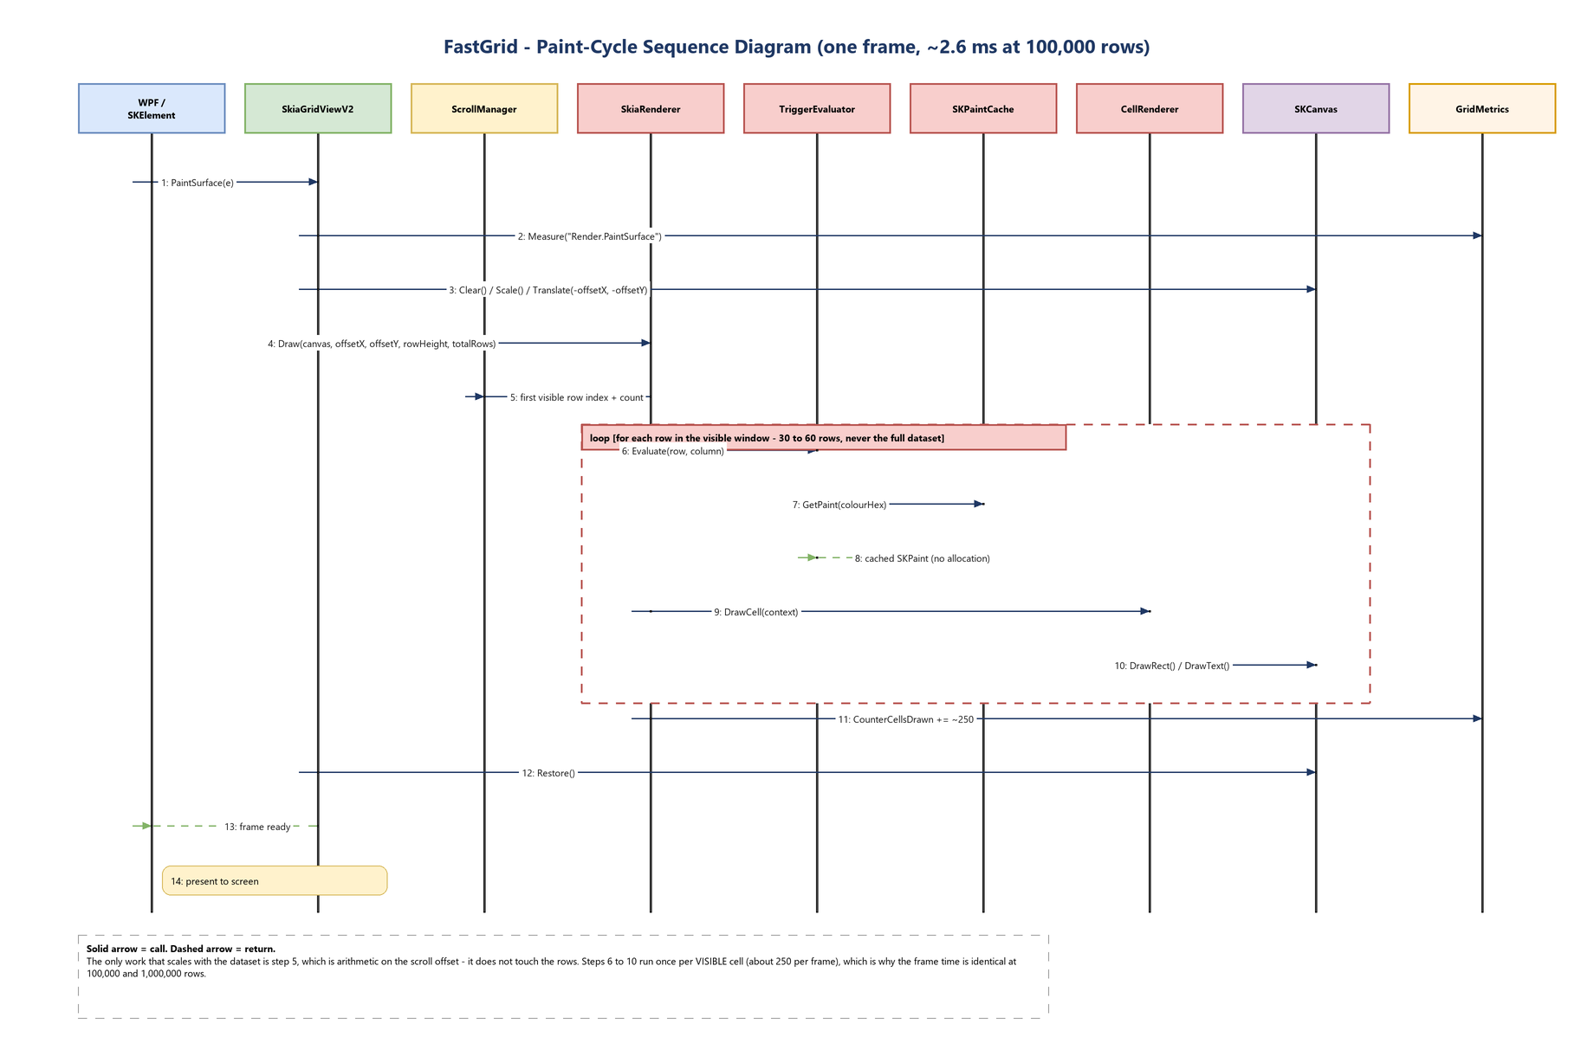
Sequence Diagram - Paint Cycle
PaintSurface -> visible window -> evaluate triggers -> draw ~250 cells -> present
Notes:
Meeting-5 deliverable. One frame, fourteen messages. The only step that touches the dataset size is step 5, and that is arithmetic on the scroll offset - it never walks the rows. Steps 6 to 10 run once per VISIBLE cell, about 250 per frame, which is why the frame time is identical at 100,000 and 1,000,000 rows.

Slide 20
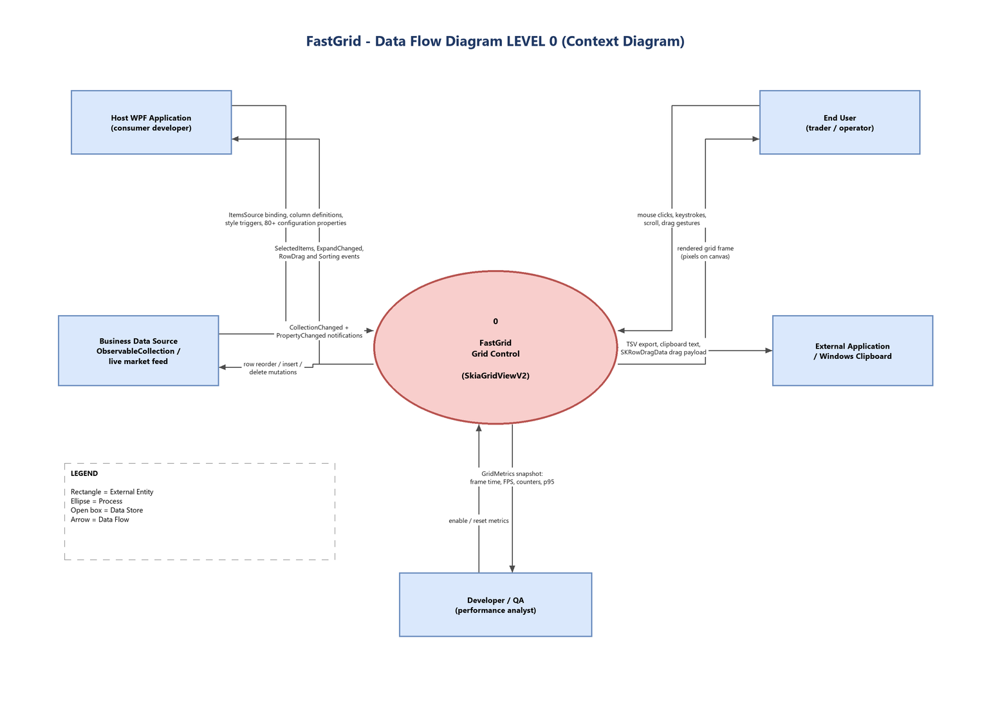
Data Flow Diagram - Level 0 (Context)
Notes:
Five external entities. Because FastGrid is a LIBRARY, the host WPF application (the consumer developer) is an external entity in its own right, separate from the end user.

Slide 21
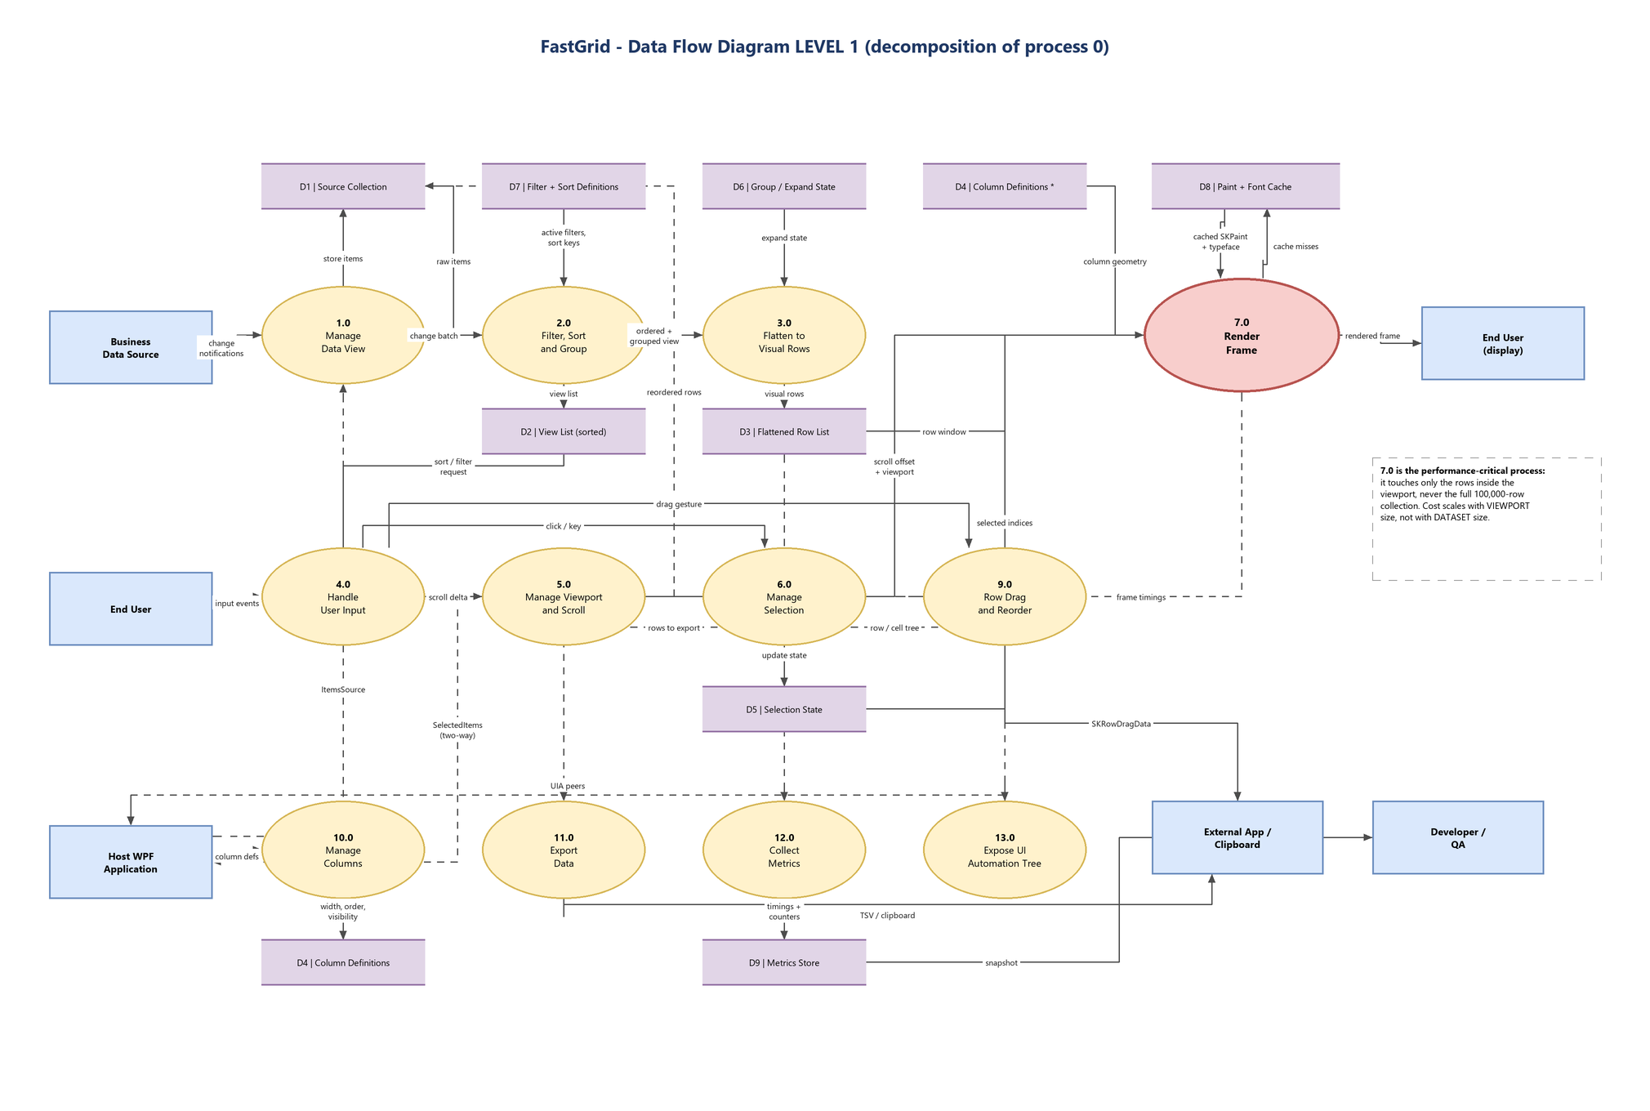
Data Flow Diagram - Level 1
Notes:
Thirteen processes and nine data stores, in three bands: top is the data pipeline (1.0 -> 2.0 -> 3.0 -> 7.0), middle is user interaction, bottom is integration and diagnostics. D4 appears twice - the standard DFD convention for a repeated store, marked with an asterisk.
Level 2 explosions of process 2.0 and 7.0 are in FastGrid_DFD.drawio as backup.

Slide 22
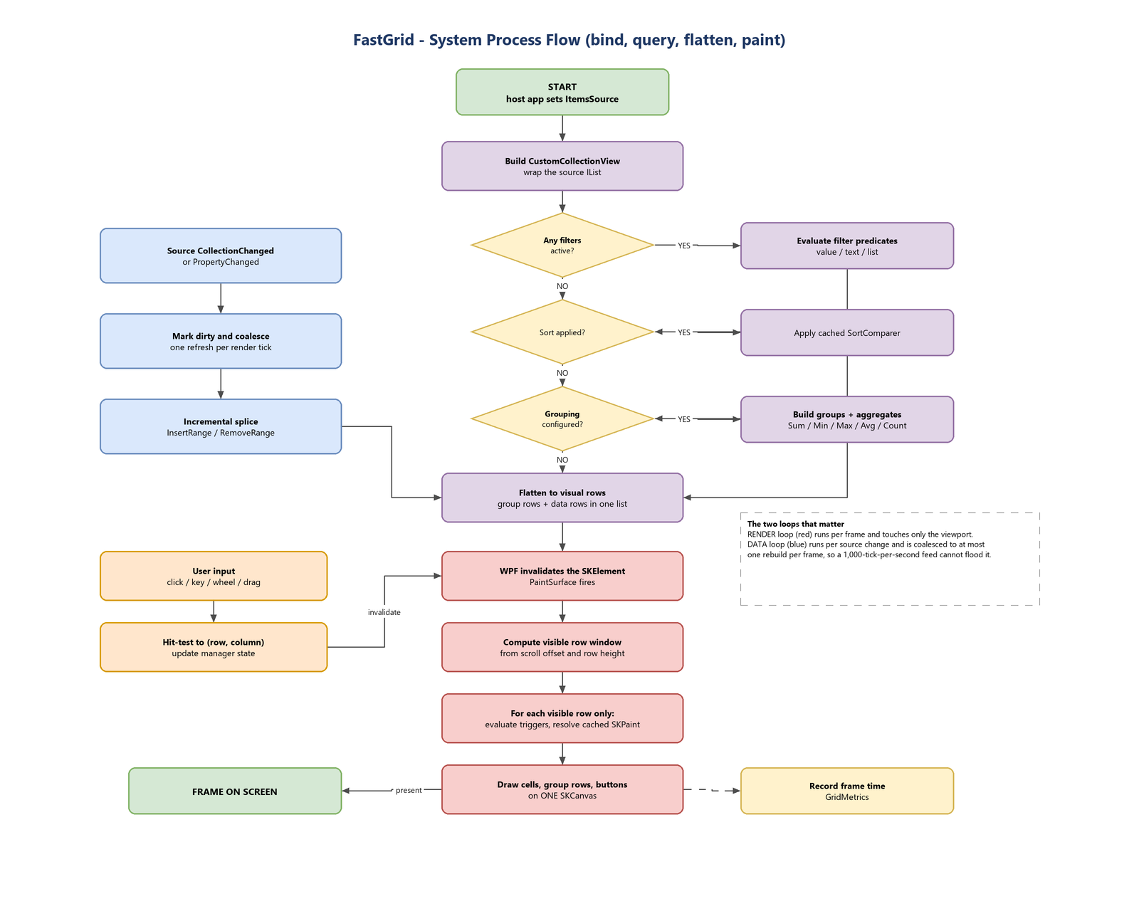
System Process Flow
Bind -> filter -> sort -> group -> flatten -> compute visible window -> draw -> present
Notes:
Two loops. The red render loop runs per frame and touches only the viewport. The blue data loop runs per source change and is coalesced to at most one rebuild per frame, so a 1,000-tick-per-second feed cannot flood it.

Slide 23
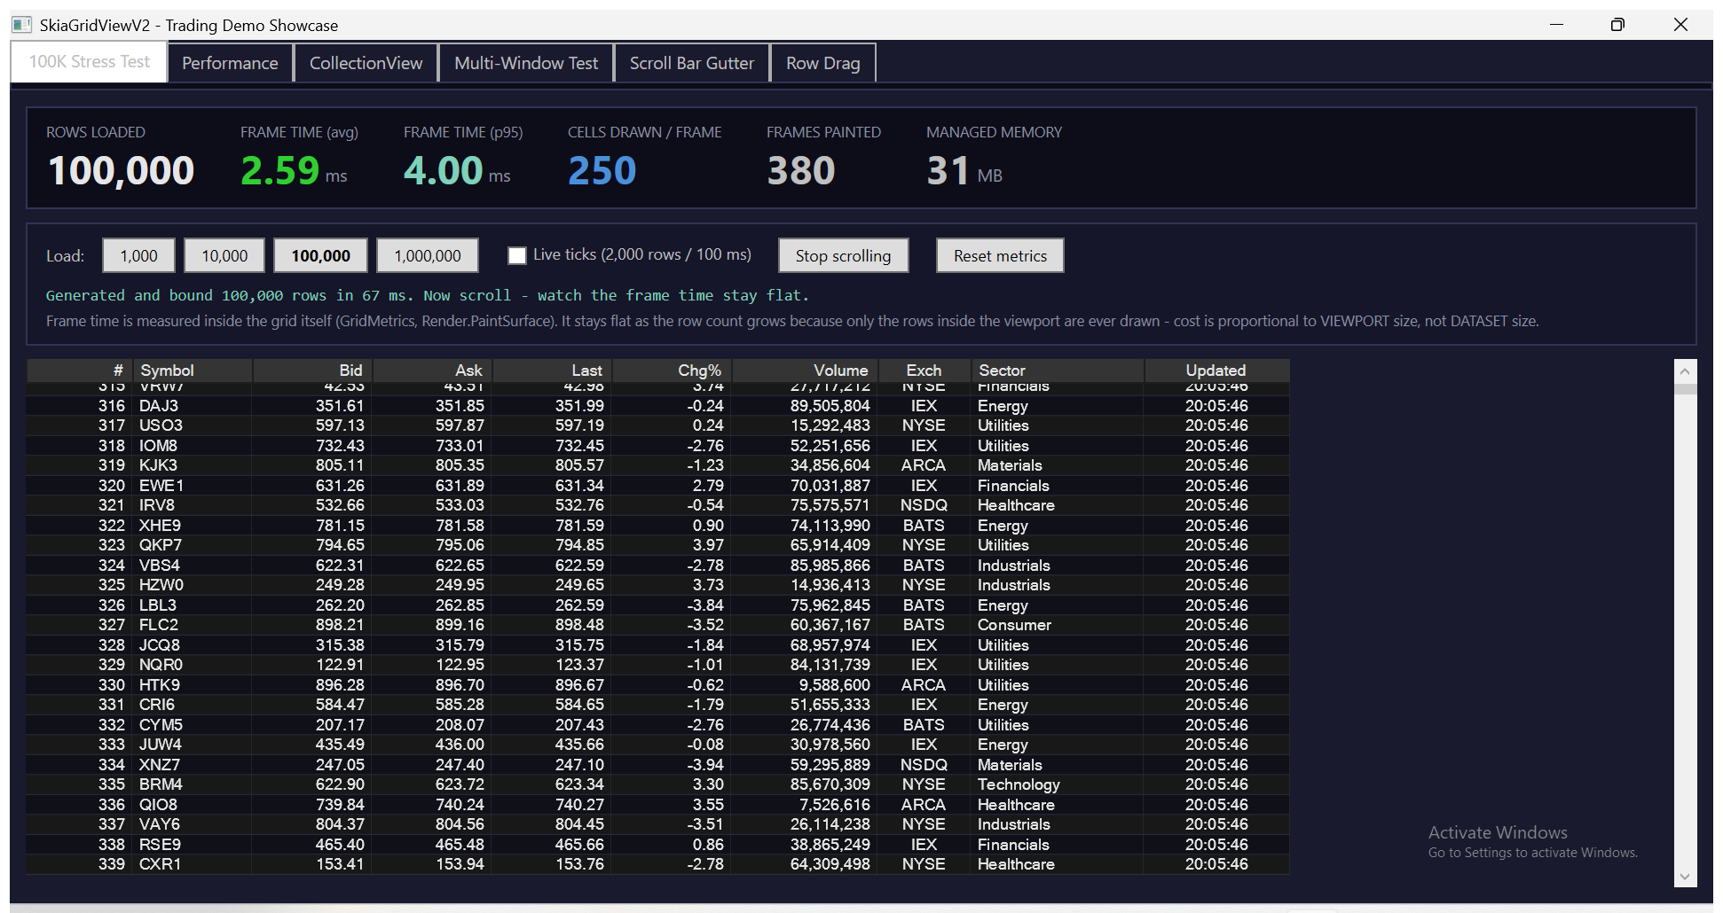
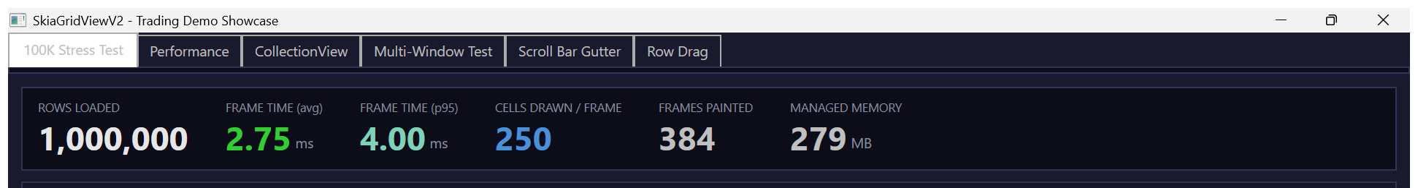
Screenshots - 100,000 / 1,000,000 Row Benchmark
100,000 rows bound in 67 ms at 2.59 ms/frame | 1,000,000 rows at 2.75 ms/frame
Notes:
Top: 100,000 rows, 2.59 ms average frame time, 4.00 ms p95, 250 cells drawn per frame, 31 MB. Bottom: the same readout at 1,000,000 rows - 2.75 ms. Identical cost at ten times the data.

Slide 24
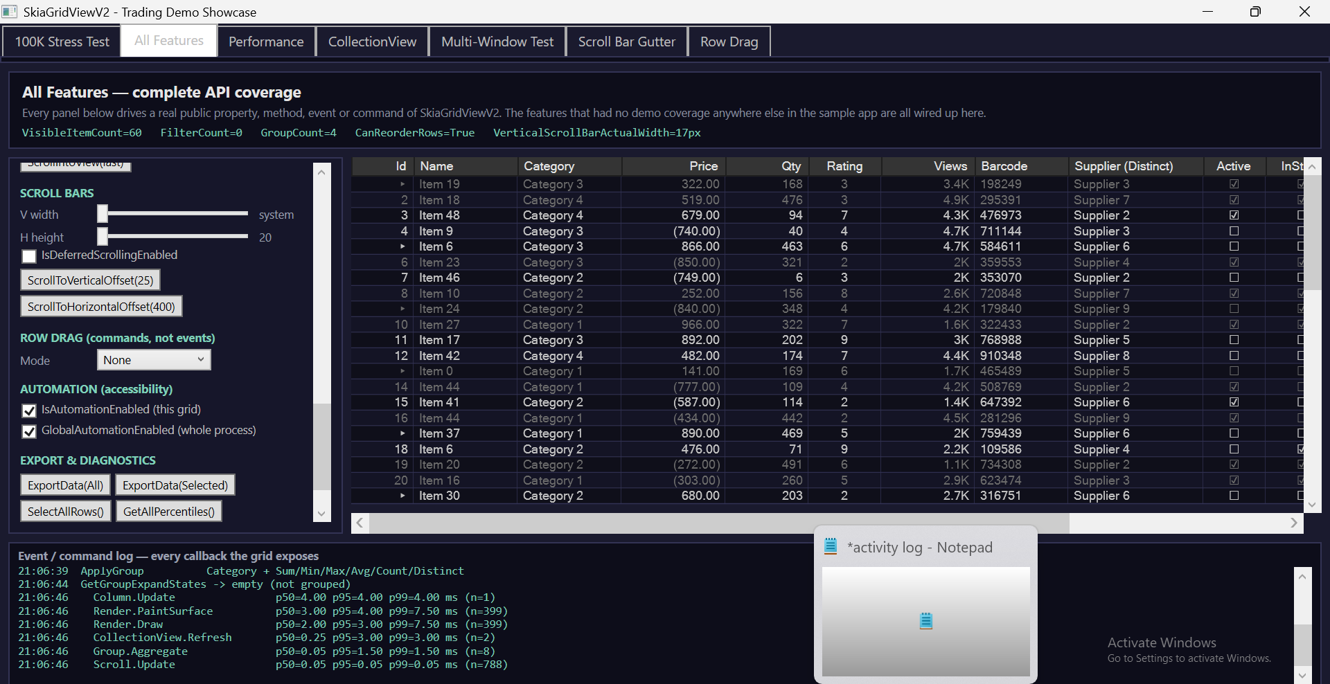
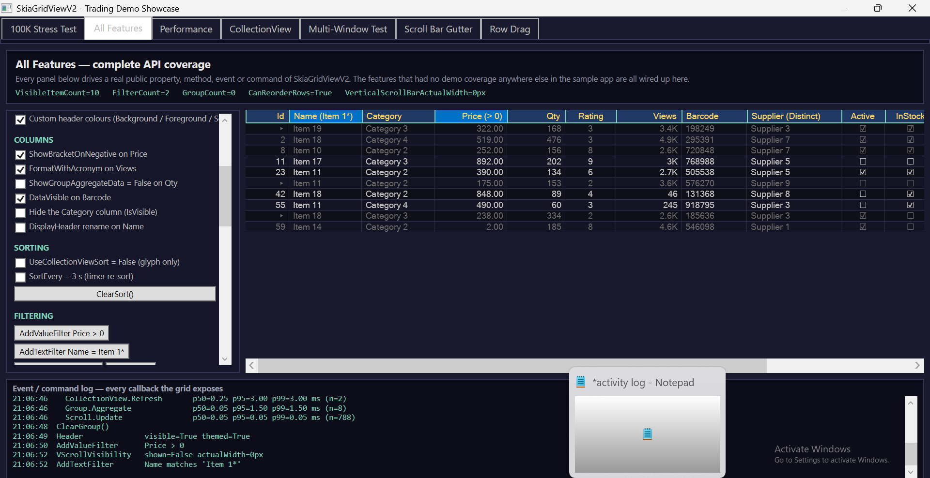
Screenshots - All Features (complete API coverage)
One tab that exercises all 306 public API members - properties, methods, events and commands
Notes:
Left: grouping with all six aggregations, tree child rows, bracketed negative numbers, acronym number formats, checkbox columns, and the live GetAllPercentiles readout in the event log. Right: custom header theming plus value and text filters applied.
Every control on the left panel drives a real public property, method, event or command - this tab exists so no part of the API is undemonstrated.

Slide 25
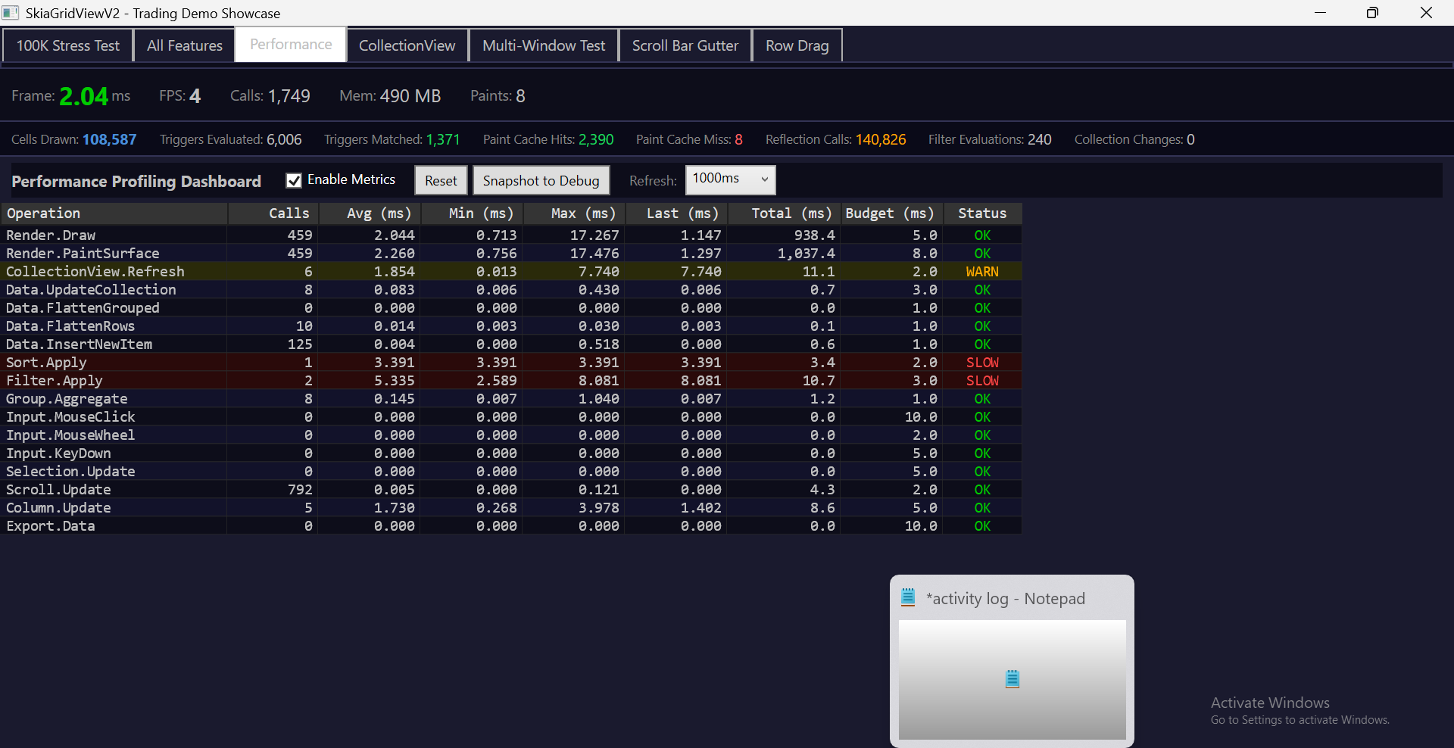
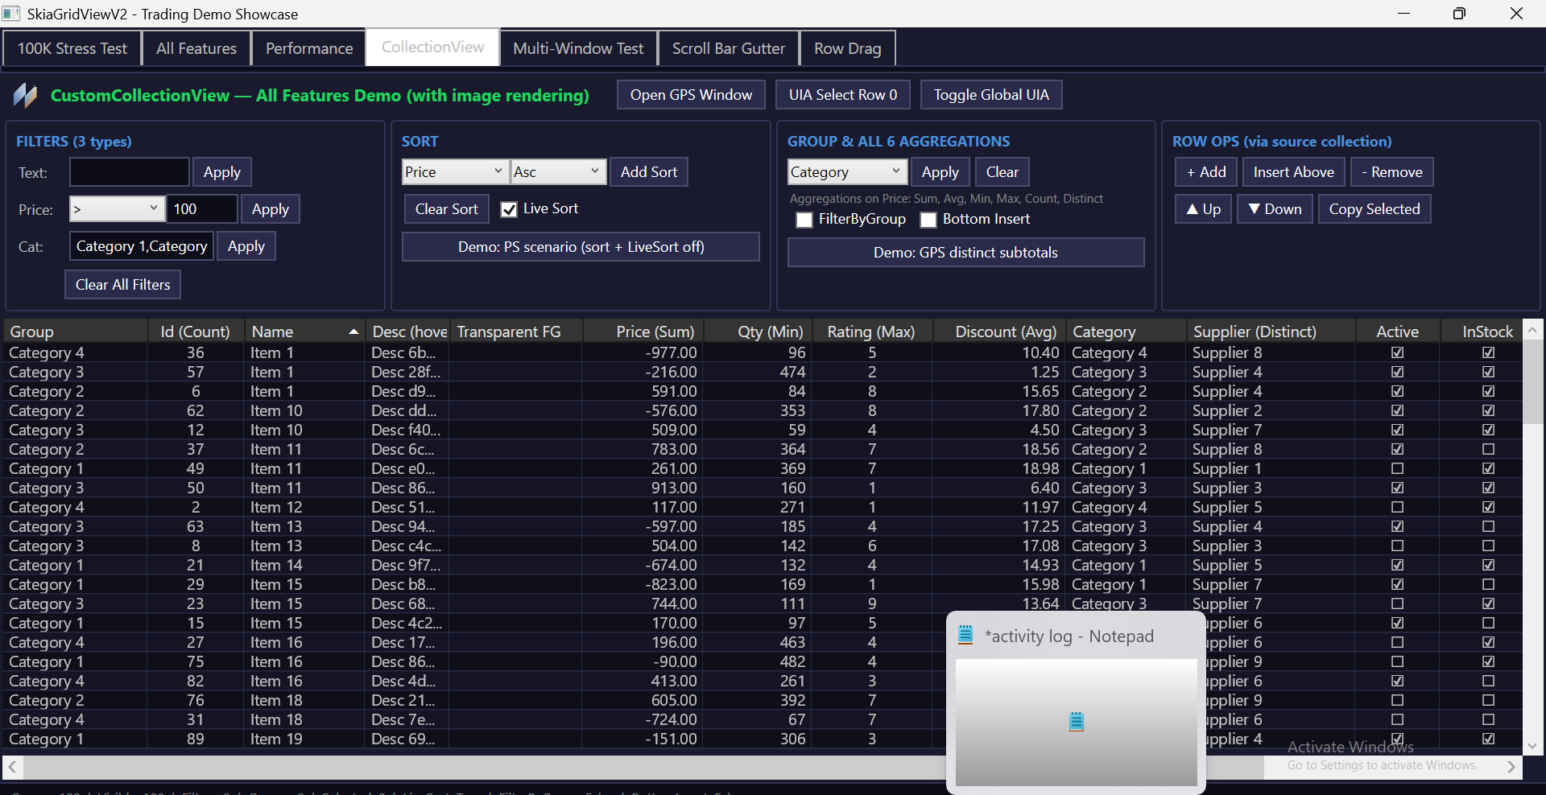
Screenshots - Instrumentation & Feature Breadth
Measurement is built into the control, not bolted on afterwards
Notes:
Left: the Performance Dashboard - 17 timed operations against per-operation budgets, plus cells-drawn, triggers-evaluated, paint-cache hit/miss and reflection counters. The metrics table is itself rendered by SkiaGridViewV2. Right: filters, sorting, grouping, checkbox columns, custom-drawn trend cells and in-cell action buttons in one view.

Slide 26
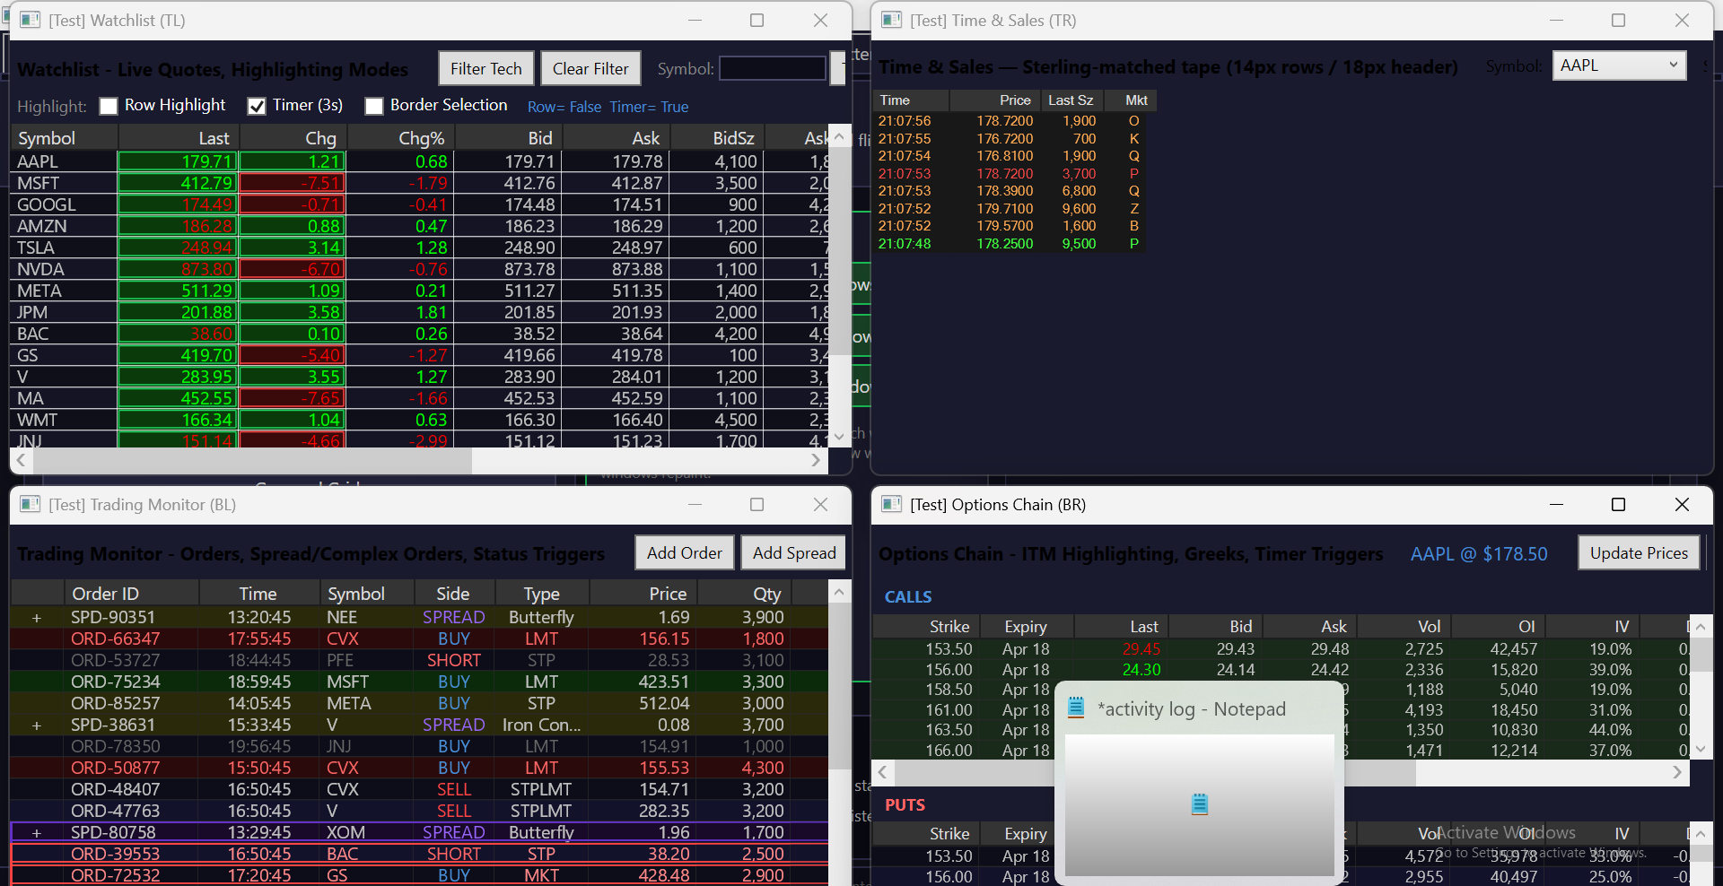
Screenshots - Four Live Trading Desks
Multi-window: independent state per grid instance, all streaming at once
Notes:
Four independently streaming grids with four independent selections: Watchlist with timer-based change highlighting, the Time & Sales tape at compact density, Trading Monitor with spread legs as tree child rows and status-driven row triggers, and an Options Chain with ITM highlighting and greeks. Per-instance renderer state and refcounted paint caches.

Slide 27
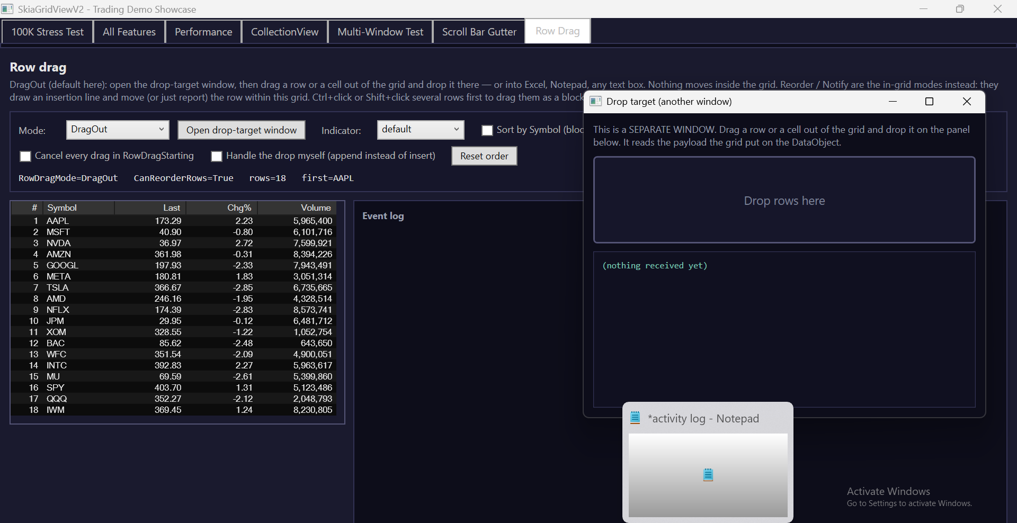
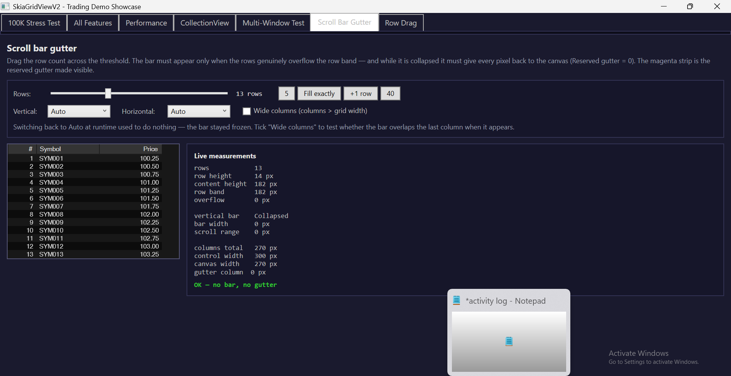
Screenshots - Row Drag & Measured QA
Cross-application drag-out | a reported defect closed with live measurements
Notes:
Left: row drag-and-drop with the drop-target window open - a real WPF DragDrop carrying live row objects plus tab-separated text, so the payload also pastes into Excel or Notepad. Right: the scroll-bar gutter harness, which reports live measurements and a PASS verdict on both sides of the Auto-visibility threshold - a defect fixed with evidence, not by eye.

Slide 28
Future Scope - Dirty-Rectangle Rendering
Today every frame repaints the whole viewport: about 250 cells, 2.59 ms, even when only a handful of cells actually changed.
Dirty-rectangle rendering: mark the cells whose data changed since the last frame, union them into a small set of rectangles, clip the canvas to those rectangles, and repaint only them.
Expected gain: on a live feed where roughly 5% of visible rows tick, per-frame draw work falls from about 250 cells to about 12 - close to an order of magnitude less work.
It is not only speed: less drawing per frame means lower CPU and power draw, and more of the 16.7 ms frame budget left for the rest of the application.
Implementation path: a per-cell dirty flag set by the change pipeline, an SKRegion accumulated per frame, SKCanvas clipping before the draw loop, and a full-repaint fallback on scroll, resize, sort, filter or group.
Validation: extend GridMetrics with a cells-redrawn versus cells-visible ratio so the saving is measured rather than assumed.
Also planned: the cloud telemetry dashboard for GridMetrics, and in-place cell editing.
Notes:
This is the FYP-II headline. The honest framing: we are already inside the 5 ms budget, so dirty rectangles are not about hitting a target we are missing - they are about cutting the cost of a frame that is mostly unchanged, which is exactly the streaming-market-data case.
If asked why it was not done now: it needs a per-cell change-tracking pipeline that the current design deliberately does not have, because re-reading every visible cell each frame is what keeps the renderer stateless and testable.

Slide 29
References / Key Technical Basis
WPF DataGrid documentation and rendering model.
SkiaSharp documentation and graphics/rendering concepts.
NuGet package management and .NET library distribution.
CI/CD practices for automated build, test, package, and release workflows.
Performance engineering: frame-time measurement and large-dataset benchmarking.

Slide 30
SRS - Functional Requirements (1 of 2)
FR-1 Data Binding - bind any collection of objects through ItemsSource; columns either declared in XAML or generated automatically.
FR-2 Immediate-Mode Rendering - paint only the rows inside the viewport onto a single SkiaSharp canvas.
FR-3 Navigation - vertical and horizontal scrolling, mouse wheel, and custom scroll bars with auto-visibility.
FR-4 Selection - single click, Ctrl+Click toggle, Shift+Click range, Ctrl+A select-all, arrow-key navigation, Ctrl+C copy.
FR-5 Sorting & Filtering - click-to-sort per column; value, wildcard-text and list filters; optional timer-based live re-sort.
Notes:
FR-1 to FR-5 are the core grid contract, each mapping to a manager class in the architecture diagram.

Slide 31
SRS - Functional Requirements (2 of 2)
FR-6 Grouping - multi-level grouping with expand/collapse and Sum, Min, Max, Average, Count and Distinct subtotals.
FR-7 Conditional Styling - data triggers and setters that recolour cells, rows and group rows at render time, including timed highlights.
FR-8 Interactive Cells - in-cell buttons (text or image), checkboxes, hover states, tooltips and ICommand/MVVM binding.
FR-9 Row Drag & Drop - reorder rows inside the grid, and drag rows out to another window or another application.
FR-10 Export & Accessibility - TSV/clipboard export, and a full UI Automation peer tree for screen readers and automated UI tests.
Notes:
FR-6 to FR-10 are the features added beyond the original 30% proof-of-concept scope. All of them are demonstrated in the All Features tab.

Slide 32
SRS - Non-Functional Requirements
NFR-1 Performance - baseline frame time below 5 ms; measured 2.59 ms at 100,000 rows.
NFR-2 Scalability - render cost is proportional to viewport size, not dataset size; 2.75 ms at 1,000,000 rows.
NFR-3 Reusability - delivered as a self-contained NuGet package with no dependency on host-application internals.
NFR-4 Maintainability - layered design; seven managers and six renderers, each with a single responsibility.
NFR-5 Reliability - 552 automated unit tests; no native crashes across sleep/resume cycles.
NFR-6 Usability - mouse and keyboard behaviour matches the native WPF DataGrid.
NFR-7 Accessibility - UI Automation tree, switchable per grid or process-wide.
NFR-8 Portability & Cost - .NET 8 on Windows; MIT licence; open-source dependencies only.
Notes:
NFR-1 and NFR-2 are the measurable ones and the benchmark screenshots are the evidence. NFR-2 is the architectural claim: frame time is flat from 1,000 to 1,000,000 rows.

